Slide 1
PROJECT: MOVIE POPULARITY TREND
4/5/2019
PROJECT TEAM
EUGENE CHU, JOHN KIM,
ANGELA ELLIS

Slide 2
PROJECT OVERVIEW
PROJECT DESCRIPTION:
FIND OUT THE TRENDS AND CORRELATION AMONG ACADEMY AWARDED MOVIES FOR BEST PICTURES AS BELOW:
MOVIE POPULARITY GENRE TREND OVER THE PAST 10
ACTOR’S SEX ORIENTATION TREND
MOVIE RELEASE MONTH/SEASON TREND
CORRELATION BETWEEN MOVIE AWARDS AND WEATHER IMPACT IN THE RELEASE DATES
PROJECT TEAM:
EUGENE CHU, JOHN KIM, AGENLA ELLIS
PROJECT TIMELINE: 3/23 ~ 4/5

Slide 3
RESEARCH PROCESS
FLOW
BRAINSTORM
IDEAS
DATA GATHERING
DATA ANALYSIS
VISUALIZATION
WHAT/HOW
PROJECT IDEA
QUESTIONS
APIs(OMDB, Gender)
JUPYTER NB
JUPYTER NB
PANDAS
DATA REVIEW
FORMAT/CLEAN
MATPLOTLIB
SUMMARIZING FINDINGS
PRESENTATION MATERIALS
TIME
LINES
4/2
3/23
3/26-4/2
4/2-4/5

Slide 4
QUESTIONS & MOTIVATION FOR PROJECT
IS THERE ANY PARTICULAR GENRE TREND FOR OSCAR
AWARDED MOVIES?
IS THERE ANY PARTICULAR SEX ORIENTATION TRENDS
FOR OSCAR AWARDED MOVIES ACTORS?
IS THERE ANY TREND FOR MOVIE RELEASE DATE/SEASONS FOR
OSCAR AWARED MOVIES?
WHAT IS THE CORRELATION BETWEEN MOVIE REVIEW RATINGS
AND ACTUAL MOVIES POPULARITY?
ARE THERE ANY WEATHER CONDITIONS ON MOVIE RELEASE DATE
INFLUENCING THE MOVIE AWARD AND POPULARITY ?
ARE THERE APIs AVAILABLE TO RESEARCH THIS PROJECT?
Notes:
The questions you and your group found interesting, and what motivated you to answer them

Slide 5
ANSWERS/FINDINGS TO QUESTIONS
IS THERE ANY PARTICULAR GENRE TREND FOR OSCAR AWARDED MOVIES?
Yes, we used APIs(OMDB) and found the genre trend
IS THERE ANY PARTICULAR SEX ORIENTATION TRENDS FOR OSCAR AWARDED MOVIES ACTORS?
Yes, we used the APIs(OMDB and GENDER) and found the sex orientation trend
IS THERE ANY TREND FOR MOVIE RELEASE DATE/SEASONS FOR OSCAR AWARED MOVIES?
Yes, we could find the release dates from csv file
WHAT IS THE CORRELATION BETWEEN MOVIE REVIEW RATINGS AND ACTUAL MOVIES POPULARITY?
Yes, we used the APIs(OMDB) and found the correlation
ARE THERE ANY WEATHER CONDITIONS ON MOVIE RELEASE DATE INFLUENCING THE MOVIE AWARD AND POPULARITY ?
No, we could not find the free weather history APIs
ARE THERE APIs AVAILABLE TO SEARCH THIS PROJECT?
Yes except weather history API
Notes:
Where and how you found the data you used to answer these questions

Slide 6
DATA EXPLORATION AND CLEANUP PROCESS
IMPORT:
JSON, MATPLOTLIB, PANDA, NUMPY, REQUESTS, TIME, DATETIME,
CALENDAR, API KEY
MAKE EMPTY LIST FOR THE MOVIES WITH HEADERS:
BEST PICTURE, YEAR, METASCORE, BOX OFFICE, IMDB VOTE, DIRECTOR,
GENRE, MAKER, ACTORS, FEMALE, AND MALE
USING FOR AND ITERROWS LOOP, GET EACH DATA FROM OMDB and
GENDER URL UNTIL FINISHED USING TRY AND EXCEPT AND GENERATE
DATAFRAME TABLE BY PANDA
FORMATING/CLEANING UP
FROM EACH ROW OF THE DATAFRAME MAKE ACTOR LIST
FOR ACTOR LIST, USING THE GENDER API , GETTING THE GENDER INFO
(FOR AND IF & ELIF LOOPS)
CONVERT THE MONTH FROM STRING TO NUMBER AND ADD COLUMNS
(RELEASE YEAR, MONTH, DATE)
GETTING THE PLOTS USING MATPLOTLIB :
PIE CHART- OSCAR WINNING NUMBERS BY MOVIE GENRE
SCATTER CHART-BOX OFFICE VS REVIEW SCORE
BAR-CHART- BAR-CHART- LEADING ACTORS GENDER COMPARISON
BAR CHART- BEST PICTURES RELEASED MONTH
Notes:
The data exploration and cleanup process (accompanied by your Jupyter Notebook)

Slide 7
ANALYSIS PROCESS
REVIEW IF ALL THE DATA IS GATHERED
DETERMINE IF EACH PLOTTING CHART WAS SELECTED APPROPRIATE
REVIEW THE PLOTTING CHARTS FOR ANY USEFUL INTERPRETATION
DISCUSS WITH THE TEAM
SUMMARIZE OUR FINDINGS FROM THE CHARTS
CHECK ANY LIMITATIONS/ASSUMPTIONS
Notes:
The analysis process (accompanied by your Jupyter Notebook)

Slide 8
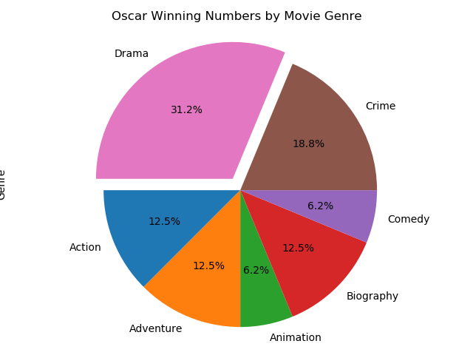
FINDINGS & CONCLUSION(1/4)
OSCAR WININNING NUMBERS BY MOVIE GENRE
DRAMA GENRE WAS THE MOST POPULAR AMONG ALL GENRES (31%)
NEXT POPULAR GENRE WAS CRIME (19%)
3RD POPULAR GENRE WAS EVENLY SHARED WITH ACTION, BIOGRAPHY, AND ADVENTURE(12%)
Notes:
Your conclusions. This should include a numerical summary as well as visualizations of that summary

Slide 9
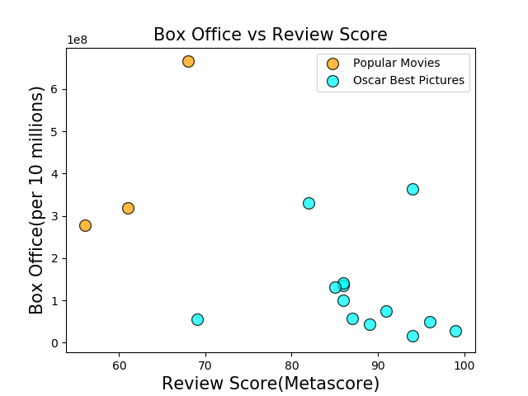
FINDINGS & CONCLUSION(2/4)
2. BOX OFFICE VS REVIEW SCORE
BOX OFFICE VS REVIEW SCORE WAS NOT CORRELATED
HIGHEST REVIEW MOVIE DOES NOT GUARANTEE THE HIGHEST BOX OFFICE MOVIE

Slide 10
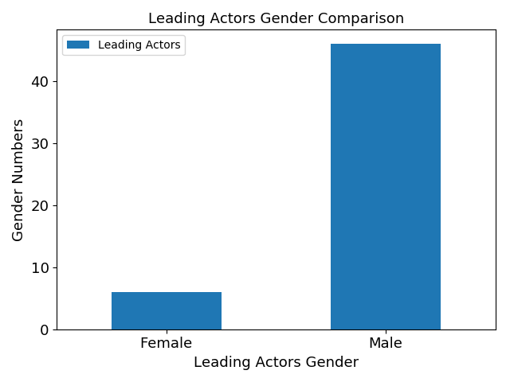
FINDINGS & CONCLUSION(3/4)
3. LEADING ACTORS GENDER COMPARISON
MALE WAS DOMINATED FOR BOX OFFICE MOVIES(54:10)

Slide 11
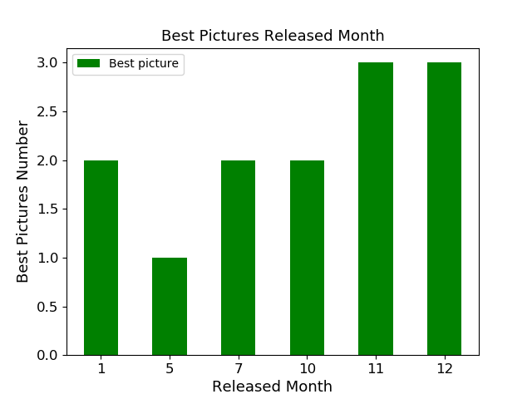
FINDINGS & CONCLUSION(4/4)
4. BEST PICTURES RELEASE MONTH
WINTER HOLIDAY SEASONS(THANKSGIVING AND CHRISTMAS) WAS BEST SEASON FOR BOX OFFICE MOVIES
THE REST OF THE SEASONS ARE SECOND POPULAR
SPRING WAS LEAST POPULAR SEASON FOR BOX OFFICE MOVIES POPULARITY

Slide 12
OTHER INSIGHTS/LIMITATIONS/ASSUMPTIONS
HOLIDAYS ARE THE RELEASE TARGETS
FOR MOVIE MAKERS, NEW MAX CINEMA WAS LEADING FOR OSCAR WINNING NUMBERS(5 TIMES), FOLLOWED BY MIRAMAX FILMS AND WARNER BROS PICTURES
WE COULD NOT FIND THE FREE WEATHER HISTORY API”S AND COULD NOT GET THE DATA ON THE QUESTION OF RELEASE DATE WEATHER IMPACT ON THE BOX OFFICE MOVIE POPULARITY
WE REMOVED SOME OF THE OSCAR MOVIES BECAUSE WE COULD NOT COMPARE APPLE TO APPLE (SOME MOVIE REVIEW DATA ARE MISSING FROM OMDB)
THE DATA HERE ARE LIMITTED FOR US REGION ONLY
Notes:
Discuss the implications of your findings. This is where you get to have an open-ended discussion about what your findings "mean".

Slide 13
Questions

Slide 14
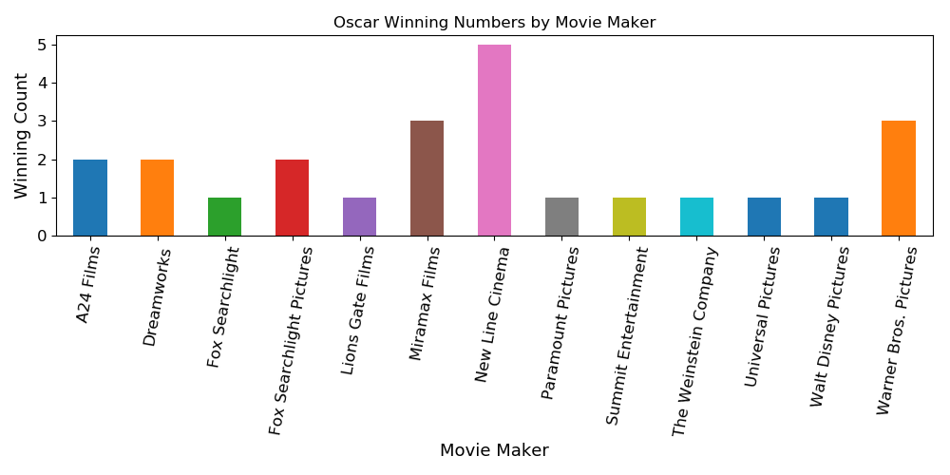
OSCAR WINNING NUMBER BY MOVIE MAKER
LEADING MOVIE MAKERS
NEW LINE CINEMA(5X)
MIRAMAX(3X)
WARNER BROS PICTURES(3X)

Slide 15
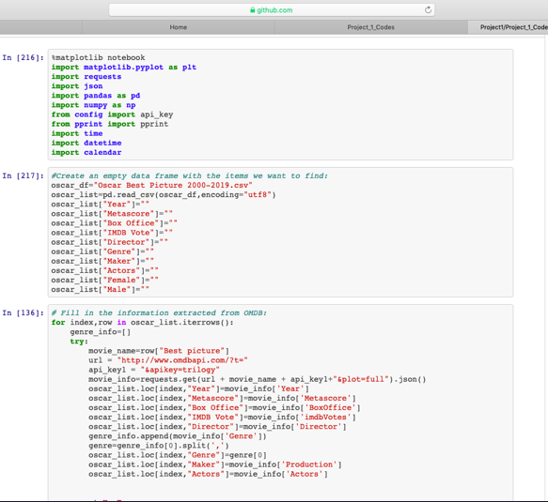
JUPYTER NOTEBOOK (1)
1. IMPORT:
JSON, MATPLOTLIB, PANDAS, NUMPY, REQUESTS, TIME, DATETIME, PPRINT, CALENDAR, API KEY
2. MAKE EMPTY DATAFRAME READING CVS FILE FOR THE MOVIES WITH HEADERS:
BEST PICTURE, YEAR, METASCORE, BOX OFFICE, IMDB VOTE, DIRECTOR, GENRE, MAKER, ACTORS, FEMALE, AND MALE
3. USING FOR AND ITERROWS LOOP, GET EACH DATA FROM OMDB and GENDER URL UNTIL FINISHED USING TRY AND EXCEPT AND GENERATE TABLE DATAFRAME BY PANDAS

Slide 16
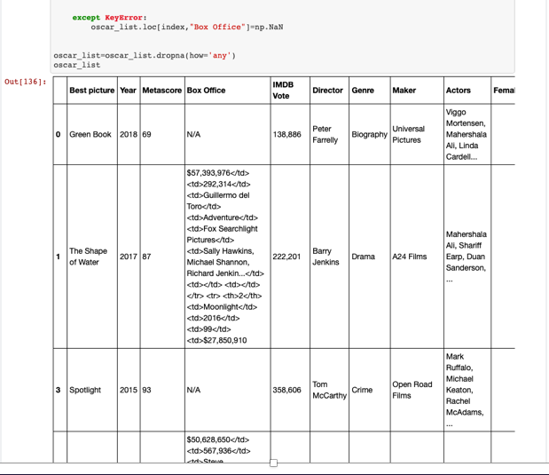
JUPYTER NOTEBOOK (2)
3. CONTINUED

Slide 17
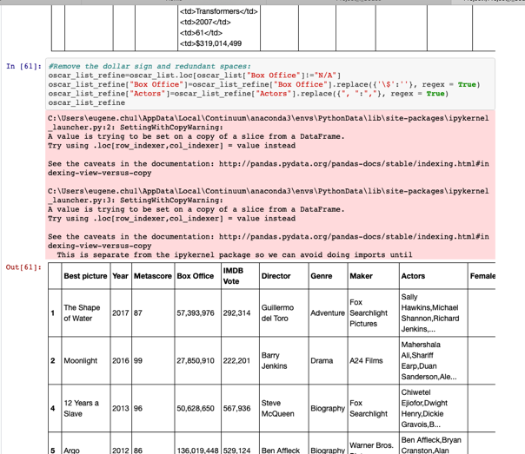
JUPYTER NOTEBOOK (3)
FORMATING/CLEANING UP

Slide 18
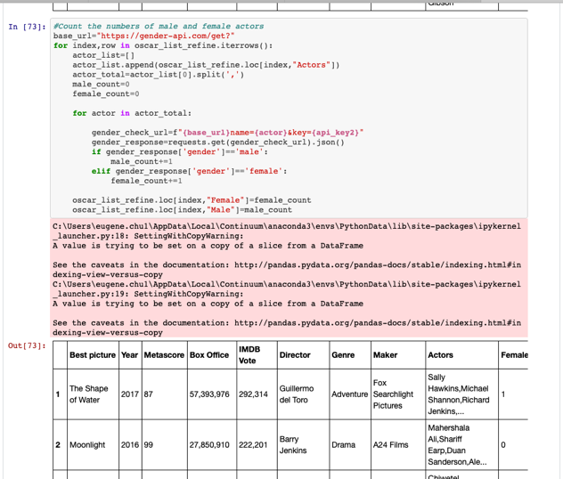
JUPYTER NOTEBOOK (4)
5. FROM EACH ROW OF THE DATAFRAME MAKE ACTOR LIST
6. FOR ACTOR LIST, USING THE GENDER API AND GETTING THE GENDER INFO (FOR AND IF & ELIF LOOPS)

Slide 19
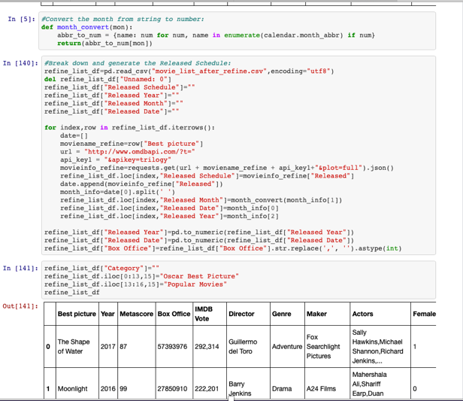
JUPYTER NOTEBOOK (5)
7. CONVERT MONTH
FROM STRING TO
NUMBER AND
ADD COLUMNS (RELEASE YEAR, MONTH, DATE) IN THE DATAFRAME

Slide 20
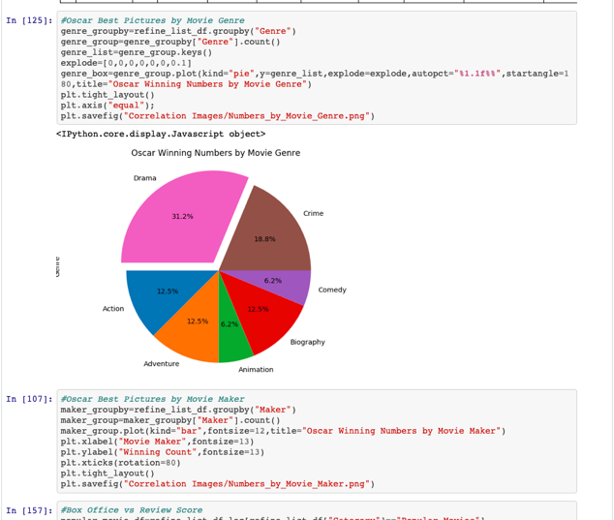
JUPYTER NOTEBOOK (6)
8-1. GETTING THE PLOTS USING MATPLOTLIB :
PIE CHART- OSCAR WINNING NUMBERS BY MOVIE GENRE

Slide 21
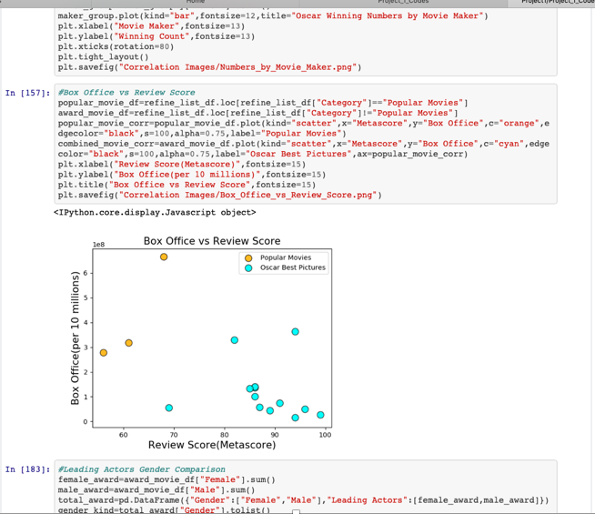
JUPYTER NOTEBOOK (7)
8-2. GETTING THE PLOTS USING MATPLOTLIB :
SCATTER CHART-BOX OFFICE VS REVIEW SCORE

Slide 22
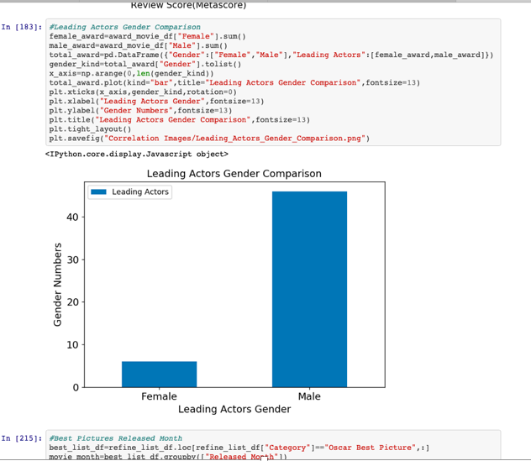
JUPYTER NOTEBOOK (8)
8-3. GETTING THE PLOTS USING MATPLOTLIB :
BAR-CHART- LEADING ACTORS GENDER COMPARISON

Slide 23
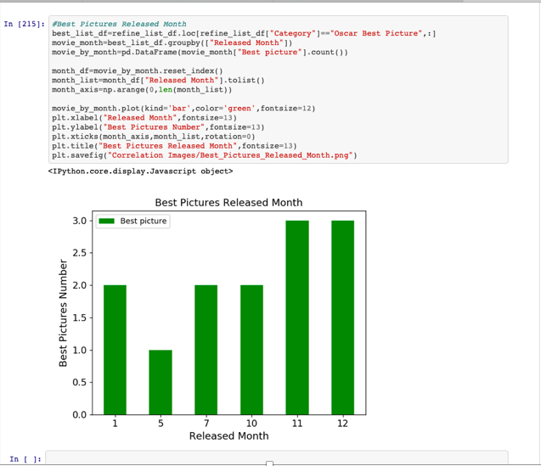
JUPYTER NOTEBOOK (9)
8-4. GETTING THE PLOTS USING MATPLOTLIB :
BAR CHART- BEST PICTURES RELEASED MONTH

